Slide 1
ME759 High Performance Computing for Applications in Engineering [Spring 2021]
Lecture 07
02/08/2021
Dan Negrut, 2021 ME759 UW-Madison

Slide 2
Quote of the day
"If I'd asked customers what they wanted, they would have said 'a faster horse’.”
-- Henry Ford [1863-1947]

Slide 3
Is BBC recording on?
If my internet connection goes down, I’ll email from my phone to provide more information – go/no-go, next step, etc.

Slide 4
Before we get started…
Last time
Caches, wrap up
The Memory Mountain experiment, and idea of effective bandwidth
Virtual memory: page translation table, TLB, page faults, etc.
Today
Wrap up Virtual memory discussion
Discuss why folks started to look into parallel computing
Flynn’s Taxonomy
Amdahl's Law
Other tidbits:
Assignment due on Th, 02/11, at 9 pm
Do not run your code on the Euler headnode (use Slurm)
Please read the ME459 “elements of C” material if malloc/new & pointers are not your friends

Slide 5
TLB related: The Address Space Identifier (ASID) [left-over slide, added owing to question posed by one of you]
The TLB does the translation from Virtual Memory into Physical Memory
At each time, there are many processes in flight; they are managed by the OS
Q: There is one TLB per core. When TLB used for quick translation, how does it now if a pageID is cached?
This is an issues since there are many processes in flight
Resolution: OS assigns each process an 8-bit Address Space Identifier (ASID)
When the TLB caches a translation, each translation has also an ASID associated with it
A “hit” means matching the ASID and the page ID

Slide 6
Memory-related aspects: various other tidbits
Going on several tangents
Virtual vs. Physical memories: how their size comes into play
Pointers in gdb/Visual Studio: pointing into virtual or physical memory?
Unit of address resolution
Difference between thread and process (came up in the context of TLP)
32 to 64 bit transition
Frame size

Slide 7
Virtual vs. Physical memories: how their size comes into play
Assumption: in this discussion we’re dealing with a 32 bit operating system
Simpler to talk about it, fewer bits/smaller memories to keep track of. Nothing changes for 64 bit OSs
Case 1: The physical memory smaller than virtual memory
Case 2: The physical memory larger than virtual memory

Slide 8
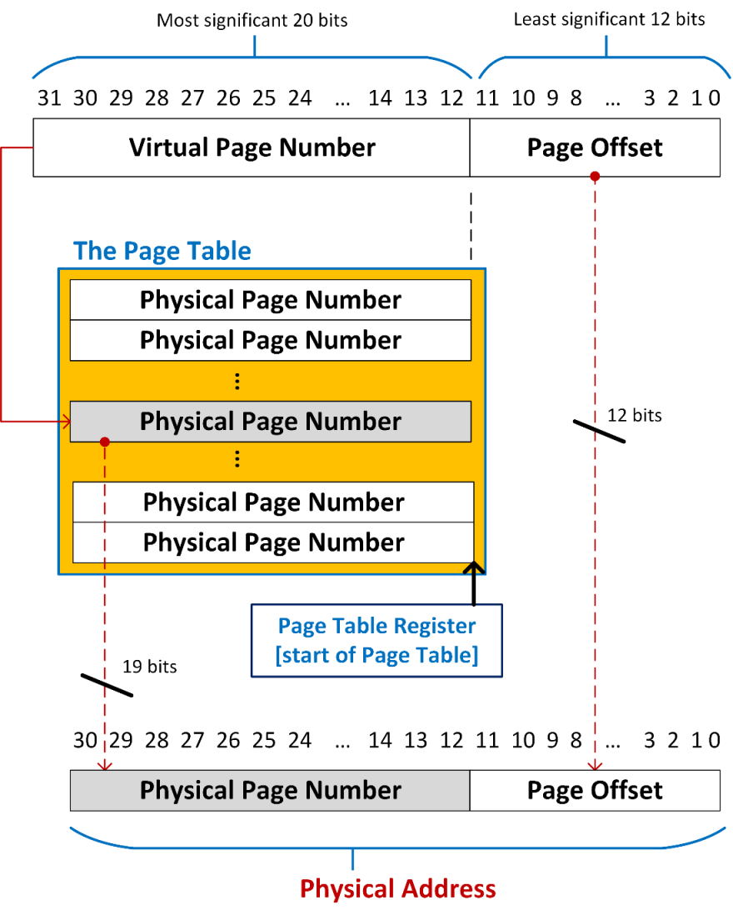
Case 1: Assume 2GB MB of RAM (my slim laptop)
2 GB of RAM: 2X more addresses in virtual memory than you have in physical memory
Depending how much memory your program uses, multiple virtual pages are going to be mapped into the same physical frame
Consequence: in reality, each entry in the Page Table always has [at least] one additional bit
clean/dirty bit – indicates that translation to frame should not proceed immediately

Slide 9
The Clean/Dirty Bit & the concept of Page Fault
Bit is “clean”: two conditions need to happen for the bit to be clean
The frame that the page gets translated into has been loaded in main memory (think onset of execution)
Since last translation, that very frame has not been associated with other virtual page
Bit is “dirty”:
We called this before “page fault”, costly scenario to handle
The OS will look for the needed frame on disk (secondary memory)
The way you can think about it: the RAM (main mem) is the cache of the hard-disk (secondary mem)
If bit in Page Table is dirty, the translation refers to address in secondary memory, not in main memory

Slide 10
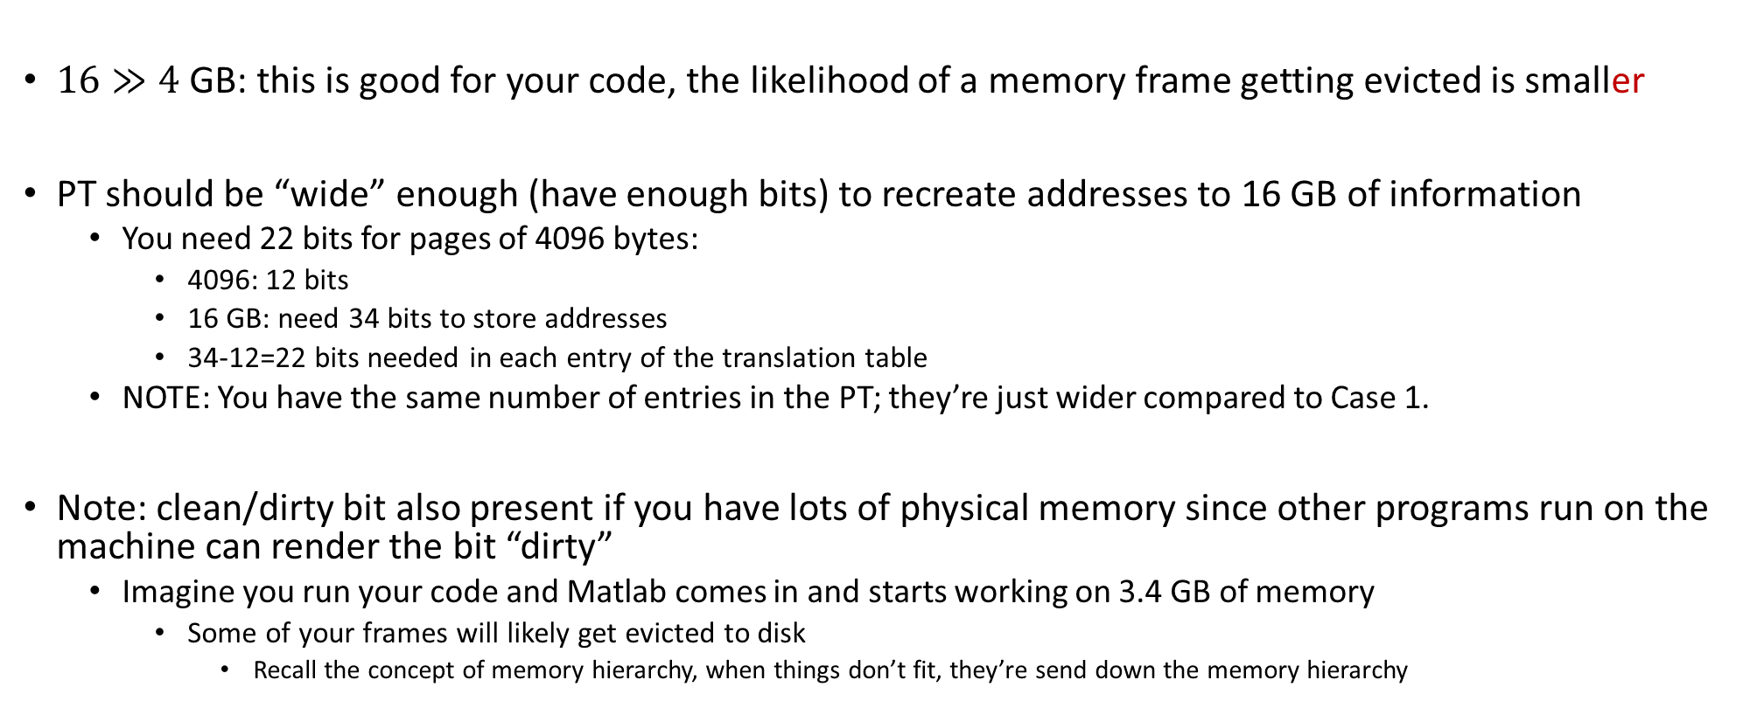
Case 2: Assume 16 GB of RAM (beefy workstation)
$16≫4$ GB: this is good for your code, the likelihood of a memory frame getting evicted is smaller
PT should be “wide” enough (have enough bits) to recreate addresses to 16 GB of information
You need 22 bits for pages of 4096 bytes:
4096: 12 bits
16 GB: need 34 bits to store addresses
34-12=22 bits needed in each entry of the translation table
NOTE: You have the same number of entries in the PT; they’re just wider compared to Case 1.
Note: clean/dirty bit also present if you have lots of physical memory since other programs run on the machine can render the bit “dirty”
Imagine you run your code and Matlab comes in and starts working on 3.4 GB of memory
Some of your frames will likely get evicted to disk
Recall the concept of memory hierarchy, when things don’t fit, they’re send down the memory hierarchy

Slide 11
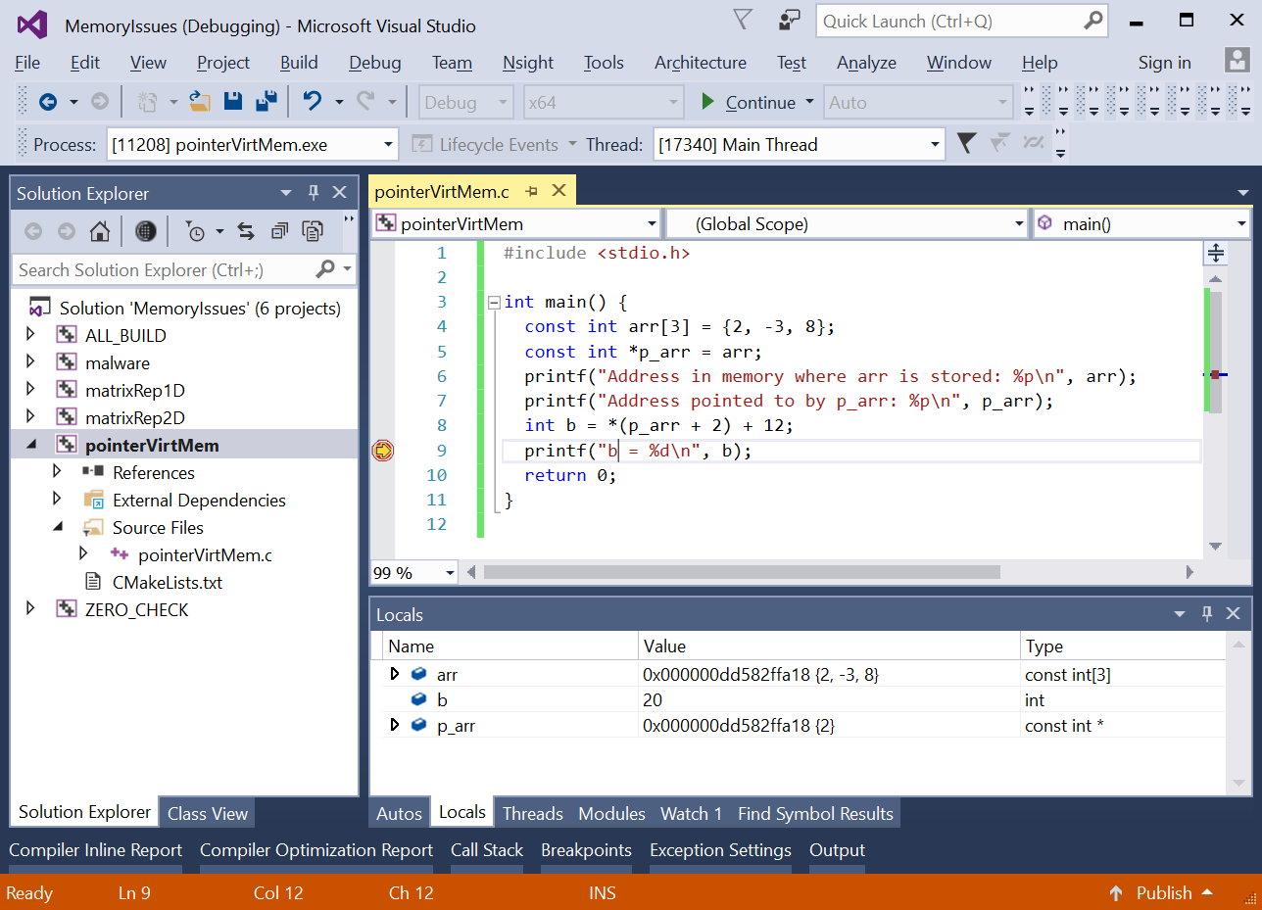
[Short Topic] gdb/VS Pointers: Pointing In Virtual or Physical Memory?
Q: Is 0x000000DD582FFA18 an address in the virtual mem. or in the physical mem.?
A: This is a virtual memory address
You see physical addresses if you are Linus Torvalds and work on kernel development
Quick note: addresses are provided in hex representation
Fewer digits to look at (would you prefer to look at 64 binary digits?)
Easy to figure out – each byte filled w/ binary digits translates into two digits out of the 16 hex digits used for the address
[https://inst.eecs.berkeley.edu/~cs61c/sp14/disc/12/dis12Sol.pdf]$→$

Slide 12
[Short Topic] The Unit of Address Resolution
How many bits are available for data storage at each address?
Example:
We have 2³² addresses that we can access
If each address points to a location that stores 8 bits (one byte) then we have 4 GB of addressable memory
However, if each address refers to a location that stores 2 bytes, we have 8 GB of addressable memory
Intel and AMD CPUs: the unit of address resolution is 1 byte (8 bits)
Consequence: the Intel 32 bit processors “see” a virtual memory space that can be 4 GB big and can reference each byte therein

Slide 13
[New Short Topic] Difference between thread and process
A processor (core) can execute instructions from multiple threads at the same time
This is a facet of TLP
Example: OpenMP launches 2 threads to perform a for-loop in parallel
A processor (core) can execute instructions from multiple processes at the same time
This is a facet of TLP
Example: the OS runs both Outlook client and Chrome, and they’re simultaneously executed
What is the difference?
The threads operate in the same virtual memory space; therefore, there is one Page Table
The processes each has its own virtual memory space; therefore, there are two Page Tables

Slide 14
In the weeds… A matter of semantics
The OS manages the execution of your program
The program is run
The processor executes [the instructions of] your program
The instructions are executed

Slide 15
[New Short Topic] The 32 to 64 bit migration (1/2)
If the architecture and OS have 32 bits to represent addresses, it means that 2³² addresses can be referenced
The data sets that we’re working with today are really large
Having only 2³² addresses to work with hardly enough
Example: I have 32 GB of RAM and need to work with 8 GB array. How do I reach the end of array? Addresses are not large enough…
This motivated push towards having addresses represented using 64 bits:
Memory space that I can address balloons to 2⁶⁴ bytes

Slide 16
The 32 to 64 Bit Migration (2/2)
Note that a 64 bit architecture typically calls for two things:
From a hardware perspective: size of the registers, translation tables, tags in caches, etc. – they need to change
From a software/OS perspective, the program “operates” in a huge virtual memory space
The new number of addressable bytes: 18,446,744,073,709,551,615
In reality, the virtual memory addresses are represented using only about 40 to 50 bits
Notes:
But, a shift from 32-bit to 64-bit isn’t an automatic win
“Your pointers will get bigger; your alignment boundaries get bigger; your data is less dense; equivalent code is bigger. You will fit less useful information into one cache line, code and data, and you will therefore take more cache misses. Everything, but everything, will suffer. Your processor's cache did not get bigger. Even other programs on your system that have nothing to do with the code you’re running will suffer. And you didn’t need the extra memory anyway. So you got nothing. Yay for speed-brakes.”
Rico Mariani (Microsoft) on why Visual Studio is still a 32-bit application

Slide 17
Example [using CAE’s tux-103]
>> less /proc/cpuinfo
processor : 0
vendor_id : GenuineIntel
cpu family : 6
model : 60
model name : Intel(R) Core(TM) i5-4570 CPU @ 3.20GHz
stepping : 3
microcode : 0x20
cpu MHz : 3197.500
cache size : 6144 KB
physical id : 0
siblings : 4
core id : 0
cpu cores : 4
apicid : 0
fpu : yes
fpu_exception : yes
cache_alignment : 64
address sizes : 39 bits physical, 48 bits virtual

Slide 18
[New Short Topic] The size of the frame/page
Refresher: a memory page, or virtual page, is a fixed-length contiguous block of virtual memory, described by a single entry in the Page Table
The frame is the fysical (or physical) counterpart of a virtual page
Typically, size of page is 4 KB but can be of 1024 KB for certain applications
Example: working with very large data sets (big data)

Slide 19
The size of the frame/page
Large page size, pros
Less TLB pressure
Why?
Fewer pages to blanket the virtual memory means fewer entries in the Page Table, which means
Fewer values that compete for storage in the TLB cache. More TLB hits: faster program
[not that big of a deal] The size of the Page Table is smaller – less memory needed to store it
Large page size, cons
Might lead to wasteful use of physical memory
Example: page size 1024 KB. If you need to allocate 1030 KB of memory, you use two pages/frames
If your process doesn’t use rest of the second page, then there’ll be a sizeable hole in physical memory

Slide 20
The size of page/frame
Architecture | Smallest page size | Larger page sizes
x86-64 | 4 KiB | 2 MiB, 1 GiB
UltraSPARC Architecture 2007 | 8 KiB | 64 KiB, 512 KiB, 4 MiB, 32 MiB, 256 MiB, 2 GiB, 16 GiB
SPARC v8 with SPARC Reference MMU | 4 KiB | 256 KiB, 16 MiB
Power Architecture | 4 KiB | 64 KiB, 16 MiB, 16 GiB
IA-64 (Itanium) | 4 KiB | 8 KiB, 64 KiB, 256 KiB, 1 MiB, 4 MiB, 16 MiB, 256 MiB
ARMv7 | 4 KiB | 64 KiB, 1 MiB, 16 MiB
32-bit x86 | 4 KiB | 2 MiB, 4 MiB
[https://en.wikipedia.org/wiki/Page_(computer_memory)]$→$

Slide 21
Departing thoughts, memory aspects
Memory transactions:
Add overhead, at times rather large, owing to complex process of moving data
From disk to main memory to cache to register
Time and power costly
Keep in mind the memory hierarchy; understand the size of the memories on your machine
The closer to the top of the hierarchy, the better off you are
If the speed of the code matters, pay attention to how you use memory

Slide 22
Parallel computing: why, and why now?

Slide 23
Acknowledgements
Sources for some of the material presented today
Hennessy and Patterson (Computer Architecture, 5th edition)
John Owens, UC-Davis
Darío Suárez, Universidad de Zaragoza
John Cavazos, University of Delaware
Others, as indicated on various slides
I apologize if I included a slide and didn’t give credit where was due
Any mistakes in these slides belong to me, not the individuals above

Slide 24
Argument made in this segment of the course
Sequential computing execution speed: only modest gains over the last decade
Parallel computing is where speed improvements have come from

Slide 25
Main causes for sequential computing speed stalling
Memory Wall
Instruction Level Parallelism (ILP) Wall
Power Wall
Not necessarily walls, but increasingly steep hills to climb
Source: “The Many-Core Inflection Point for Mass Market Computer Systems”, by John L. Manferdelli, Microsoft Corporation
Notes:
Predicted in 2000:

Slide 26
Memory Wall
Memory Wall: What is it?
The growing disparity of speed between CPU and memory outside the chip
Memory accesses have gradually become a mighty barrier to computer performance improvements
The trend: ever growing caches to improve average memory reference time to fetch or write instructions or data
Caches are a transistor black hole
Also, as cache gets gradually larger, it also gets gradually slower
Memory Wall: due to latency and limited communication bandwidth beyond chip boundaries.

Slide 27
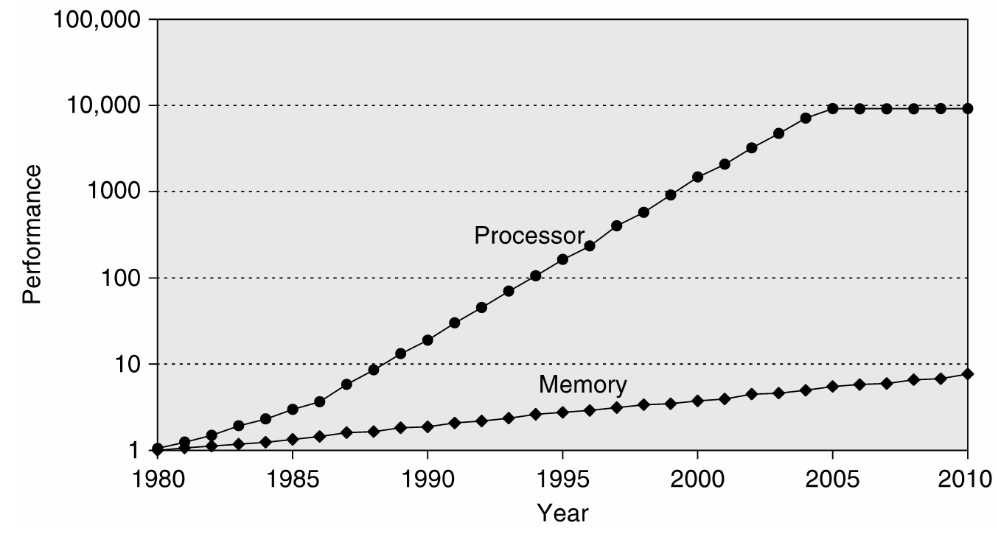
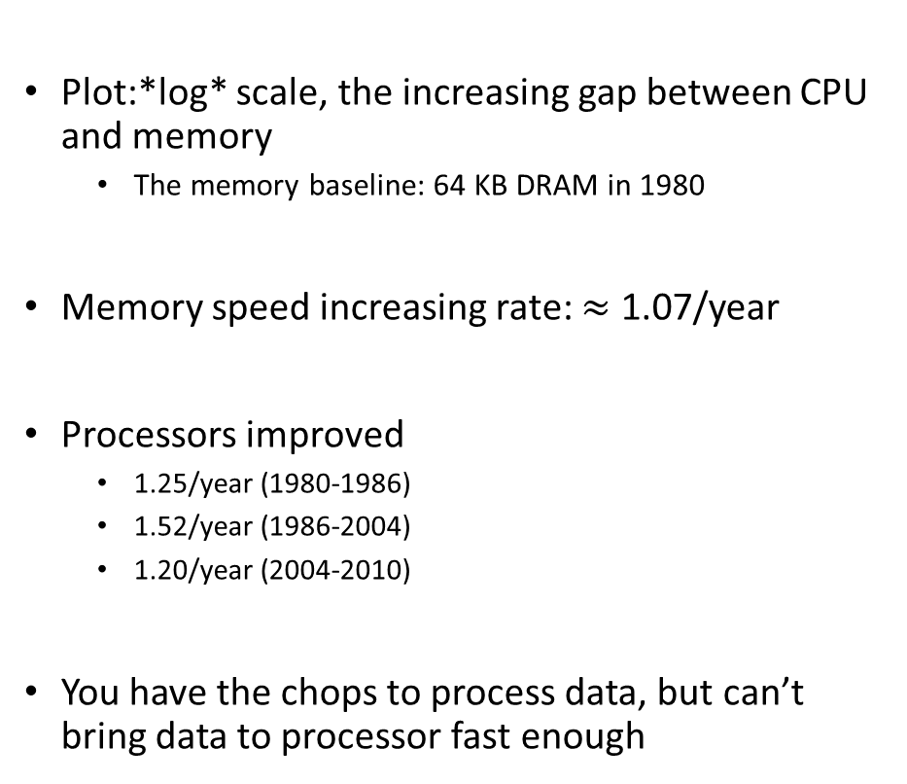
Memory Speed: Widening of the Processor-DRAM Performance Gap
Plot:*log* scale, the increasing gap between CPU and memory
The memory baseline: 64 KB DRAM in 1980
Memory speed increasing rate: $≈$ 1.07/year
Processors improved
1.25/year (1980-1986)
1.52/year (1986-2004)
1.20/year (2004-2010)
You have the chops to process data, but can’t bring data to processor fast enough

Slide 28
Memory Latencies [typical server and mobile computers]
Server
CPU
Registers
Mobile
Courtesy of Elsevier, Computer Architecture, Hennessey and Patterson, fifth edition
Notes:
Hammad: in the fifth edition of the book embedded/mobile have their own diagram

Slide 29
Memory Latency vs. Memory Bandwidth
Latency [in our context]: how much time it takes a packet of data to get from one designated point to another
Measured in seconds, also called “lag”
The utility “ping” in Linux measures the latency of a network
For memory transactions: send 32 bits to destination and back, measure how much time it takes gives you latency
Bandwidth: how much data can be transferred per second
You can talk about bandwidth for memory but also for a network (Ethernet, Infiniband, modem, DSL, etc.)
Improving Latency and Bandwidth
Mostly the job of folks in Electrical Engineering
Once in a while, Materials Science colleagues deliver a breakthrough
Promising technology: optic networks; layered memory on top of chip; etc.

Slide 30
Memory Latency vs. Memory Bandwidth
Memory Access Latency more challenging to improve as opposed to improving Memory Bandwidth
Improving Bandwidth: add more “pipes”
Requires more pins that come out of the chip for DRAM, for instance
Adding more pins is not simple – very crowded real estate plus the technology is tricky
Improving Latency: no easy answer here
Analogy:
If you carry commuters with a train, add more cars to a train to increase bandwidth
Improving latency requires the construction of high speed trains (expensive/complex)

Slide 31
Latency vs. Bandwidth: Recent Evolution of Speed Gains
Courtesy of Elsevier, Computer Architecture, Hennessey and Patterson, fifth edition
Notes:
For the Microprocessor this is measured in MIPS (million instructions per second). Many reported IPS values have represented "peak" execution rates on artificial instruction sequences with few branches, whereas realistic workloads typically lead to significantly lower IPS values.

Slide 32
Memory Wall, Conclusions [IMPORTANT SLIDE]
Take-home message: try to stay away from long and winding conversations with main memory
Memory-wise, you may or may not be at top speed for your memory
Effective bandwidth==Nominal bandwidth: you move lots of data - ok, fact of life, some applications are just like that
Effective bandwidth < Nominal bandwidth: you bring a block of data, use little of it, and ask for data from a different block
Examples – sparse matrix operations, combinatorics, etc.
Where we saw this: the memory mountain

Slide 33
Memory Wall, Conclusions [IMPORTANT SLIDE]
This is an important picture to have in mind when writing software
Courtesy of Elsevier, Computer Architecture, Hennessey and Patterson, fifth edition

Slide 34
The next wall: Instruction Level Parallelism (ILP)
Instruction pipelining: the execution of multiple instructions overlapped; each instructions is divided into series of sub-steps (termed: micro-operations)
Superscalar execution: multiple execution units are used to execute multiple instructions in parallel
Out-of-order execution: instructions execute in any order but without violating data dependencies
Register renaming: a technique used to avoid data hazards and thus lead to unnecessary serialization of program instructions
Speculative execution: allows the execution of complete instructions or parts of instructions before being sure whether this execution is required
Branch prediction: used to avoid delays (termed: stalls). Used in combination with speculative execution.

Slide 35
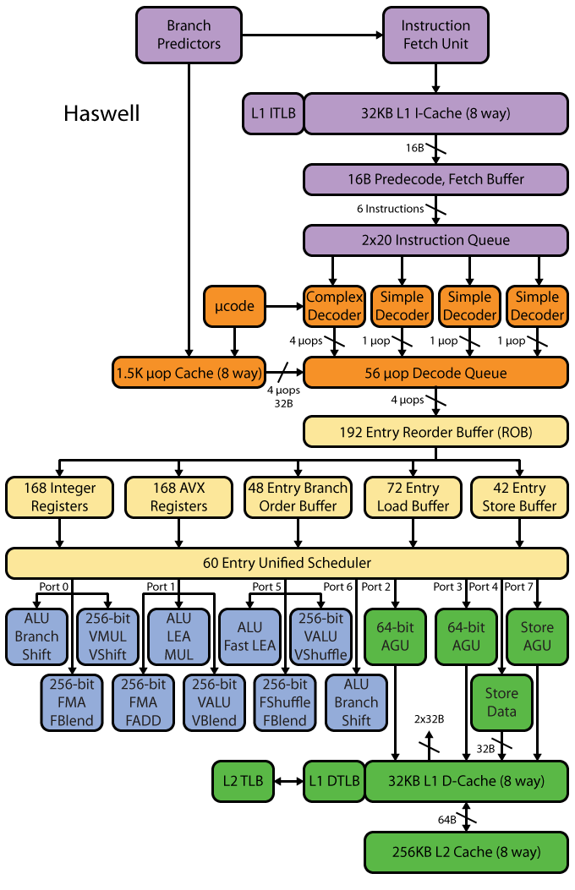
Intel Haswell example: ILP elicits very complex microarchitecture
[http://www.realworldtech.com/haswell-cpu/ ]→
Notes:
Dan - AGU: Address generation unit

Slide 36
Sample Pipeline Depths
Pipeline Depth | Processors
6 | UltraSPARC T1
7 | PowerPC G4e
8 | UltraSPARC T2/T3, Cortex-A9
10 | Athlon, Scorpion
11 | Krait
12 | Pentium Pro/II/III, Athlon 64/Phenom, Apple A6
13 | Denver
14 | UltraSPARC III/IV, Core 2, Apple A7/A8
14/19 | Core i*2/i*3 Sandy/Ivy Bridge, Core i*4/i*5 Haswell/Broadwell
15 | Cortex-A15/A57
16 | PowerPC G5, Core i*1 Nehalem
18 | Bulldozer/Piledriver, Steamroller
20 | Pentium 4
31 | Pentium 4E Prescott
[http://www.lighterra.com/papers/modernmicroprocessors/]→

Slide 37
The ILP Wall
Dedicated hardware speculatively executes future instructions before the results of current instructions are known, while providing hardware safeguards to prevent the errors that might be caused by out of order execution
Branches must be “guessed” to decide what instructions to execute simultaneously
If you guessed wrong, you throw away that part of the result
Data dependencies may prevent successive instructions from executing in parallel, even if there are no branches
Predicting the future comes at the cost of microarchitecture complexity and power cost

Slide 38
The ugly head of speculative execution
Speculative execution difficult to implement safely
Has become infamous for recently-revealed vulnerabilities
Foreshadow (Intel, 2018)
Meltdown (Intel, Apple)
Spectre (Intel, Apple, ARM, AMD)
Everything before 2019 that uses branch prediction
Arbitrary locations in the allocated memory of a program can be read

Slide 39
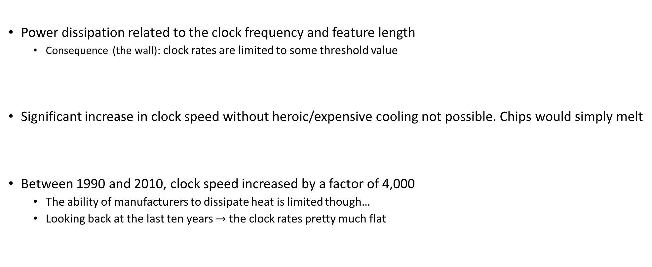
_{[The last wall]} The Power Wall
Power dissipation related to the clock frequency and feature length
Consequence (the wall): clock rates are limited to some threshold value
Significant increase in clock speed without heroic/expensive cooling not possible. Chips would simply melt
Between 1990 and 2010, clock speed increased by a factor of 4,000
The ability of manufacturers to dissipate heat is limited though…
Looking back at the last ten years $→$ the clock rates pretty much flat

Slide 40
The Power Wall
Power, and not manufacturing, limits traditional general purpose microarchitecture improvements
Point made already in 1999 by F. Pollack, Intel Fellow, see here .
Kind of true, but sadly Intel not pushing the manufacturing frontier anymore. Taiwan & S. Korea do.
Leakage power dissipation gets worse as gates get smaller, because gate dielectric thicknesses decrease proportionately

Slide 41
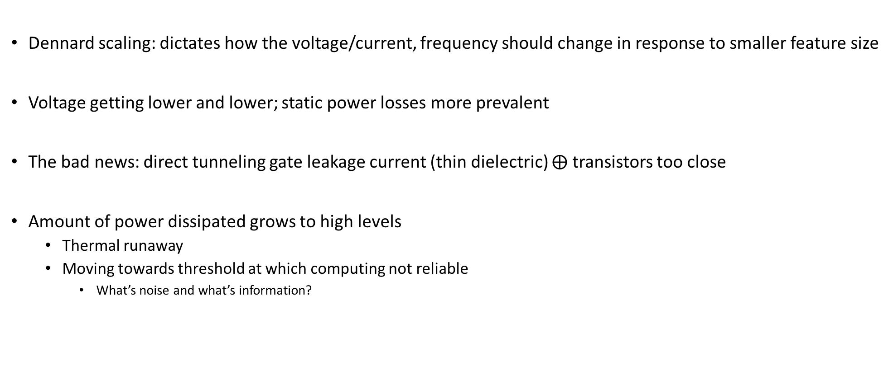
Dennard’s Scaling: Making Moore’s Law Useful
Dennard scaling: dictates how the voltage/current, frequency should change in response to smaller feature size
Voltage getting lower and lower; static power losses more prevalent
The bad news: direct tunneling gate leakage current (thin dielectric) $⨁$ transistors too close
Amount of power dissipated grows to high levels
Thermal runaway
Moving towards threshold at which computing not reliable
What’s noise and what’s information?

Slide 42
The “dark silicon”
Dark Silicon: transistors that manufacturers cannot afford to turn on
Too many transistors on a chip – cannot afford to power them lest the chip melts
Esmaeilzadeh, H.; Blem, E.; St.Amant, R.; Sankaralingam, K.; Burger, D., "Dark silicon and the end of multicore scaling," in Comp. Architecture (ISCA), 2011 38th Annual International Symp., pp.365-376, 2011

Slide 43
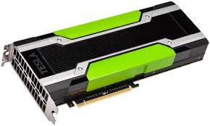
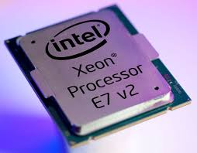
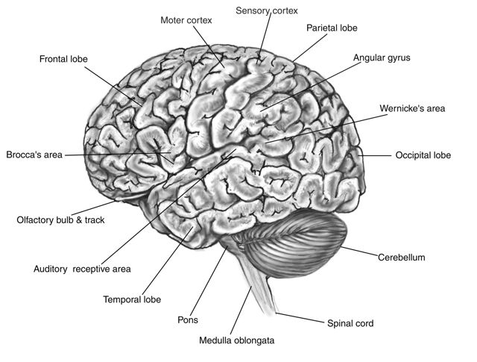
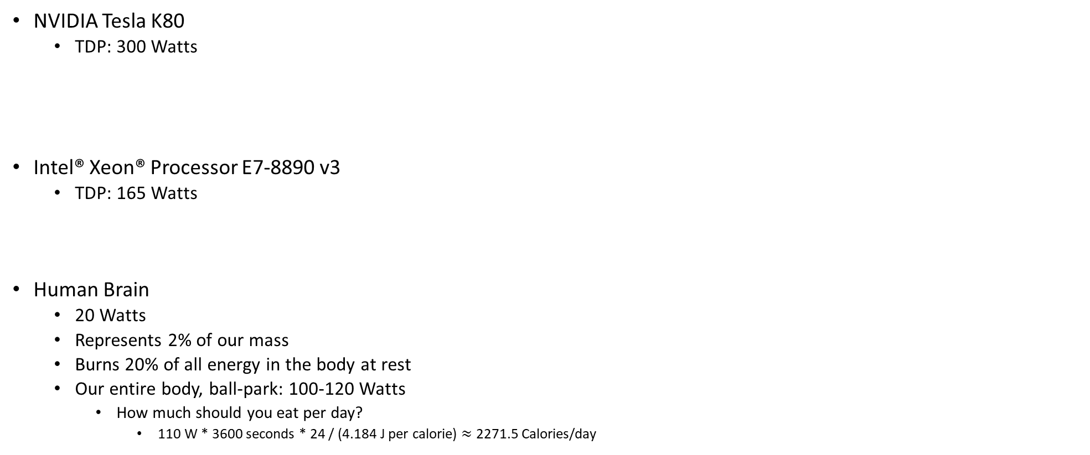
One slide detour: “spending energy” rates & how much you should eat per day
NVIDIA Tesla K80
TDP: 300 Watts
Intel® Xeon® Processor E7-8890 v3
TDP: 165 Watts
Human Brain
20 Watts
Represents 2% of our mass
Burns 20% of all energy in the body at rest
Our entire body, ball-park: 100-120 Watts
How much should you eat per day?
110 W * 3600 seconds * 24 / (4.184 J per calorie) $≈$ 2271.5 Calories/day
Notes:
[DN]
For a Opteron 6276, TDP is 115 W.
The Thermal Design Power (TDP) is the average maximum power a processor can dissipate while running commercially available software. TDP is primarily used as a guideline for manufacturers of thermal solutions (heatsinks/fans, etc) which tells them how much heat their solution should dissipate. TDP is not the maximum power the CPU may generate - there may be periods of time when the CPU dissipates more power than designed, in which case either the CPU temperature will rise closer to the maximum, or special CPU circuitry will activate and add idle cycles or reduce CPU frequency with the intent of reducing the amount of generated power.
TDP is usually 20% - 30% lower than the CPU maximum power dissipation.

Slide 44
Shift in Perception
Yesterday’s school of thought
Today’s take
Increasing clock frequency is primary method of performance improvement
Processors parallelism is primary method of performance improvement
Yesterday’s school of thought
Today’s take
Less than linear scaling for a multiprocessor is failure
Even sub-linear speedups are beneficial as long as you beat the sequential on a watt-to-watt basis

Slide 45
Conventional Wisdom in Computer Architecture
Power Wall
Old: Transistors expensive; Power is free
New: Transistors free; Power management very challenging (consequences, “lots of power”: heat to be dissipated & battery management)
Old: Math is slow; Memory access is fast
New: Math is fast; Memory slow (120 cycles for DRAM memory access, 1 cycle for pipelined FMA)
Old: Increasing Instruction Level Parallelism hardware and compilers (Out-of-order, speculation, VLIW, …)
New: ILP sees diminishing returns; non-ILP parallelism pursued
Memory Wall
ILP Wall
Notes:
Power wall + Memory wall + ILP wall → BRICK wall

Slide 46
Running against walls and such, seems to be all bad news…
OK, now what?

Slide 47
Another quote of the day
“The report of my death was an exaggeration.”
-- Mark Twain, American writer, humorist, entrepreneur, publisher, and lecturer [1835-1910]

Slide 48
The bright spot
We can produce small[er] transistors and we are increasingly good at packaging them in ICs

Slide 49
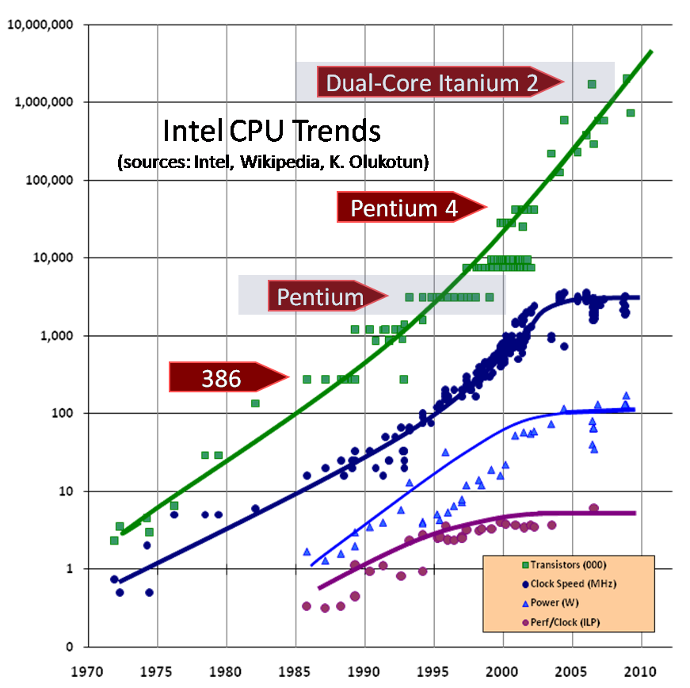
Good news: number of transistors going up

Slide 50
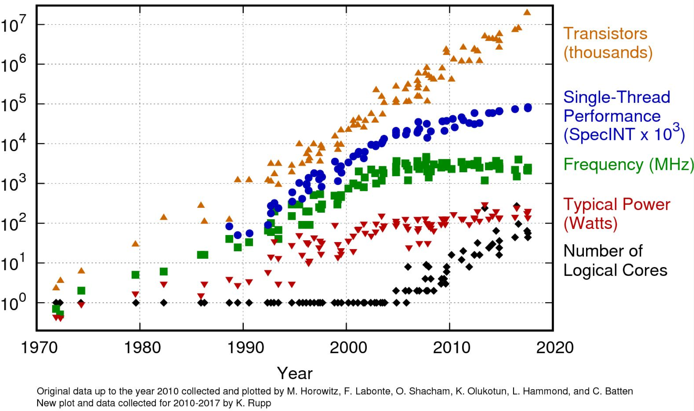

A more up-to-date plot, slightly different information
Research into multicore starting
Moores Law
Power wall
[Kunle Olukotun]$→$

Slide 51
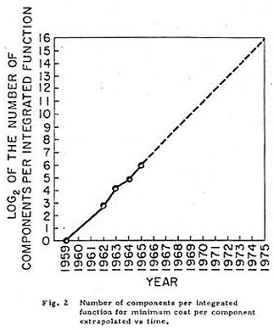
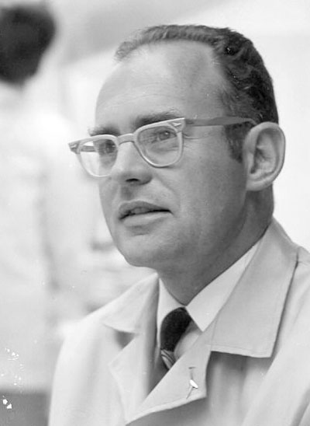

Moore’s Law
1965 paper: Doubling of the number of transistors on integrated circuits every two years
Moore himself wrote only about the density of components (or transistors) at minimum cost
http://news.cnet.com/Images-Moores-Law-turns-40/2009-1041_3-5649019.html

Slide 52
Moore’s Law (1965)
“The complexity for minimum component costs has increased at a rate of roughly a factor of two per year [see graph on next page]. Certainly over the short term this rate can be expected to continue, if not to increase. Over the longer term, the rate of increase is a bit more uncertain, although there is no reason to believe it will not remain nearly constant for at least 10 years. That means by 1975, the number of components per integrated circuit for minimum cost will be 65,000. I believe that such a large circuit can be built on a single wafer.”
“Cramming more components onto integrated circuits” by Gordon E. Moore, Electronics, Volume 38, Number 8, April 19, 1965

Slide 53
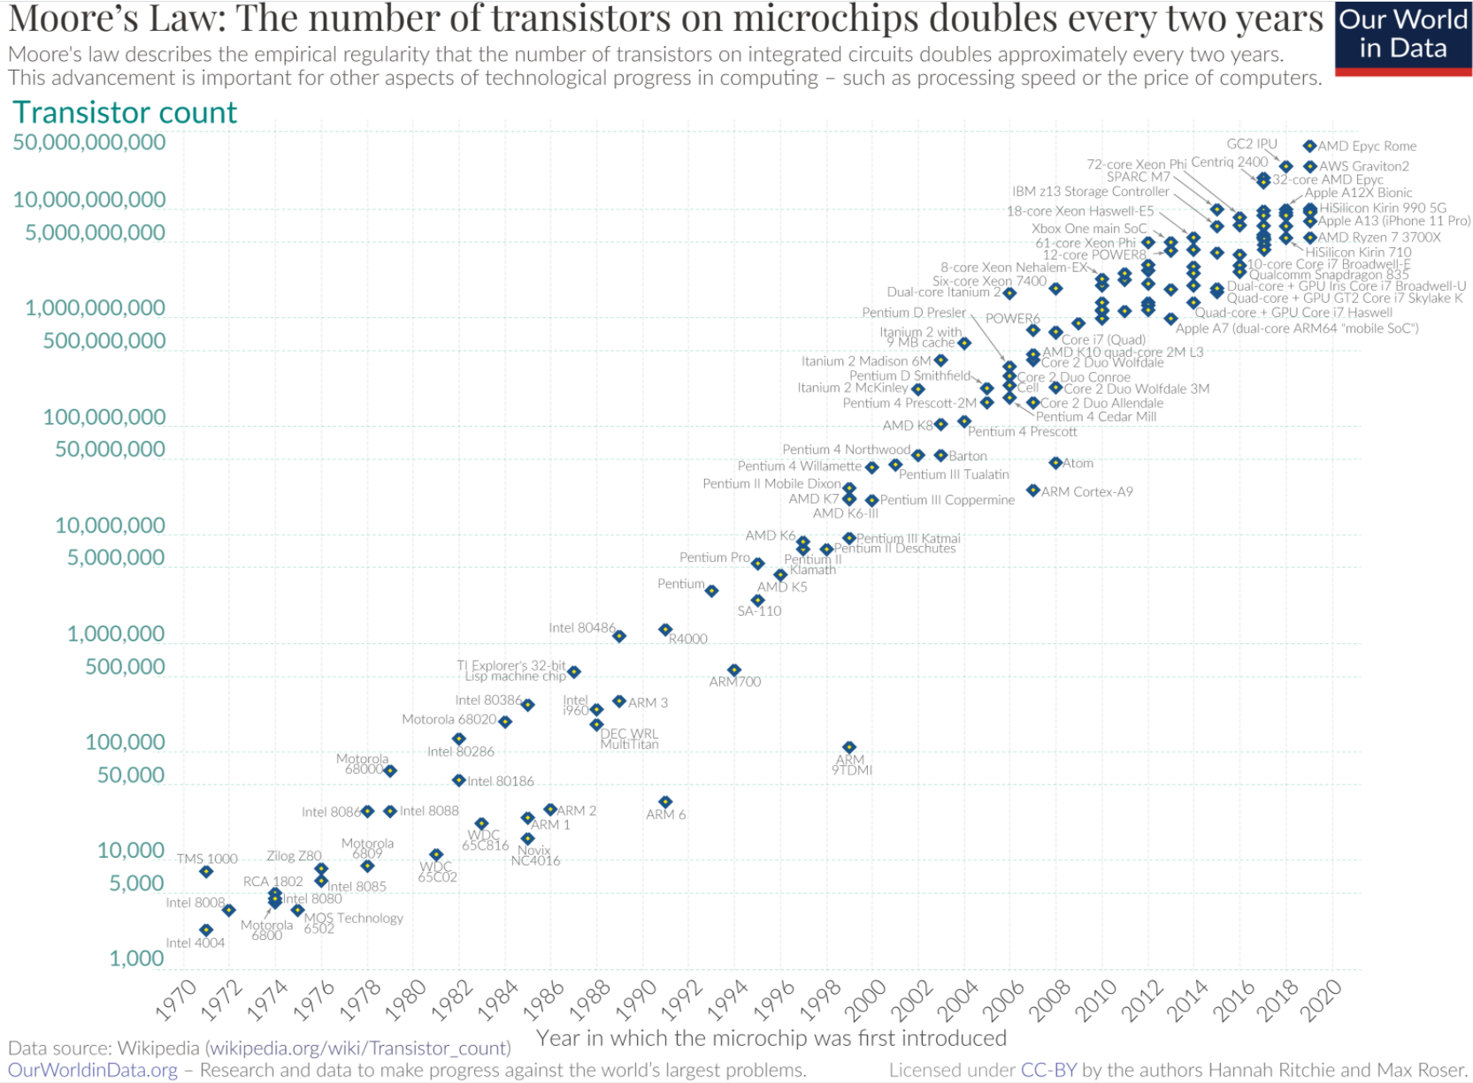

Slide 54
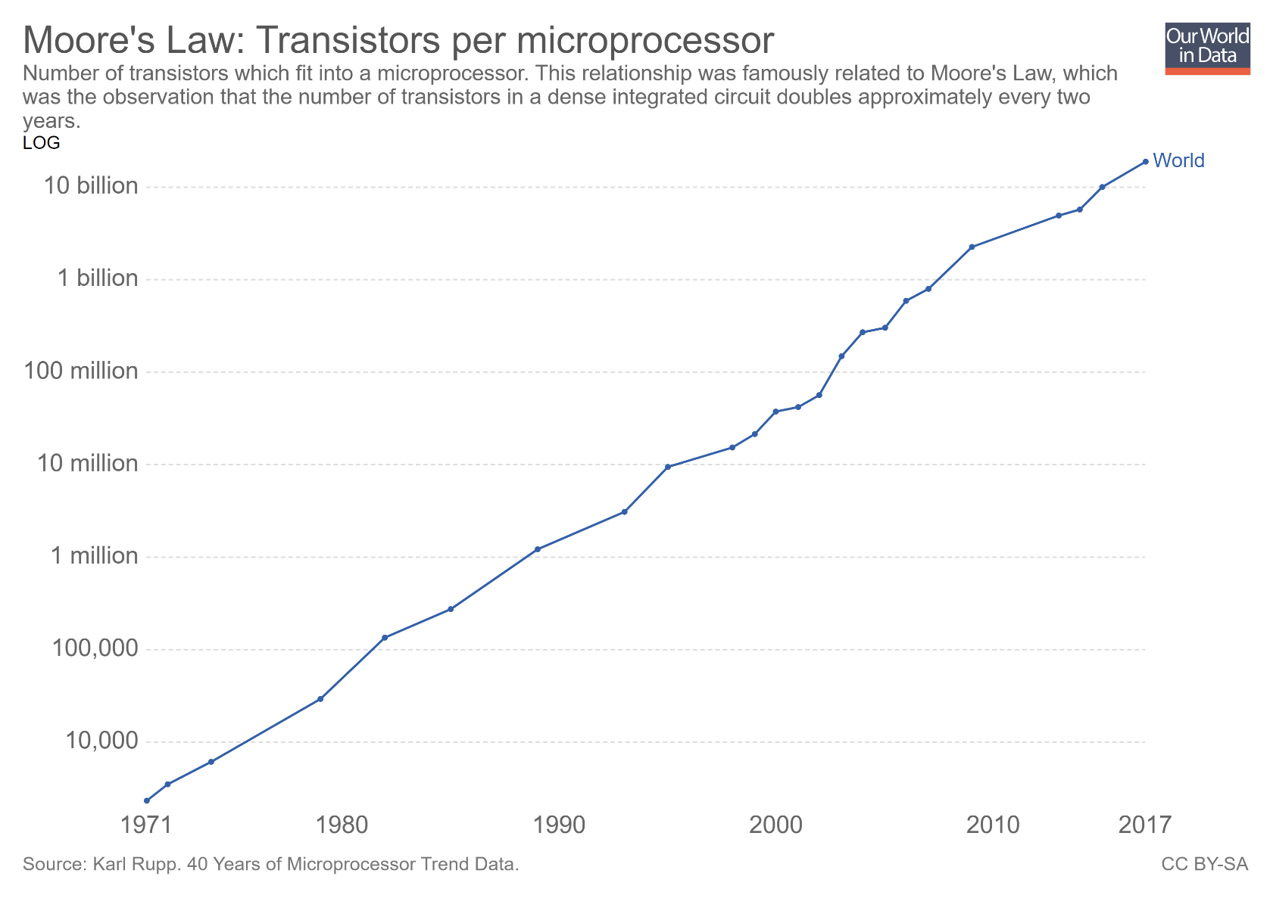
Moving to the processor: transistor counts per microprocessor

Slide 55
Intel Roadmap [or other folks’ roadmap]
2013 – 22 nm Tick: Ivy Bridge – Tock: Haswell
2015 – 14 nm Tick: Broadwell – Tock: Skylake
2016 – 14nm “Refresh” Kaby Lake
2017 – 10 nm Cannon Lake (delayed to 2019)
2019 – 7 nm [AMD: Radeon Instinct MI60/Zen2]
2021 – 5 nm (Samsung & TSMC, in testing)
2023 – 3 nm (Samsung?)
Intel has been alluding to 1.4 nm by 2029, see discussion here.
Notes:
Hammad: Even intel is having problems going down in process technologies. 10nm was delayed until the second half of 2017. Broadwell didn’t have good yields, they never released a desktop version (only laptop) and went straight to skylake for desktop CPUs

Slide 56

Plot of the day
[OurWorldInData.org]$→$

